Slide 1
ASP.NET Razor Pages
Medhat Elmasry

Slide 2
What are ASP.NET Razor Pages
ASP.NET Razor Pages is a server-side, page-focused framework that enables building dynamic, data-driven websites with clean separation of concerns.

Slide 3
Benefits
Lightweight
Flexible
Full control over HTML
Cross-platform

Slide 4
How?
.NET Core
SDK (software development kit)
Runtime

Slide 5
Why
Easy to learn
Well supported
Robust

Slide 6
Technologies
C#
Razor templating syntax
C# in HTML

Slide 7
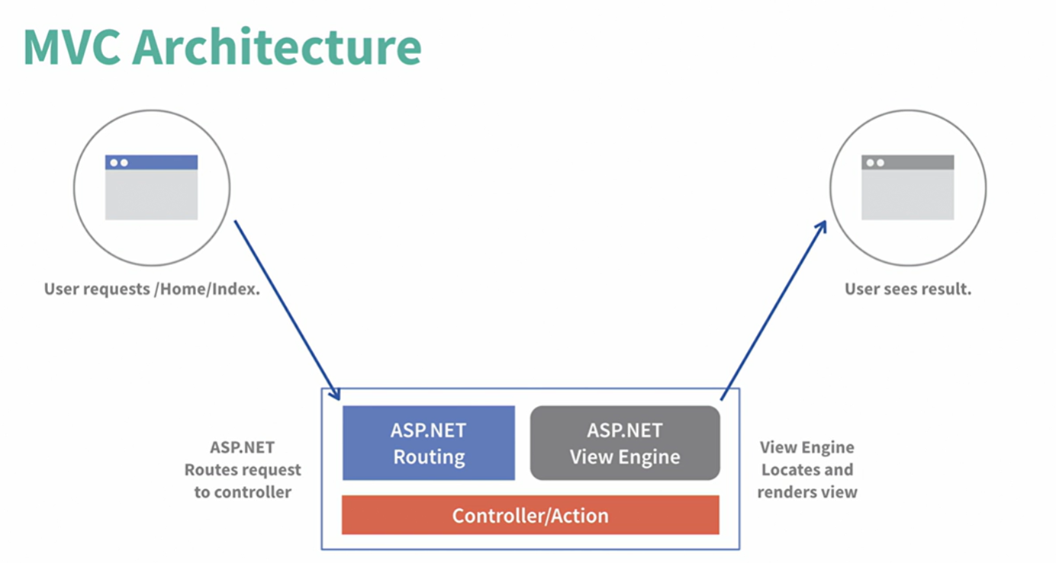

Slide 8
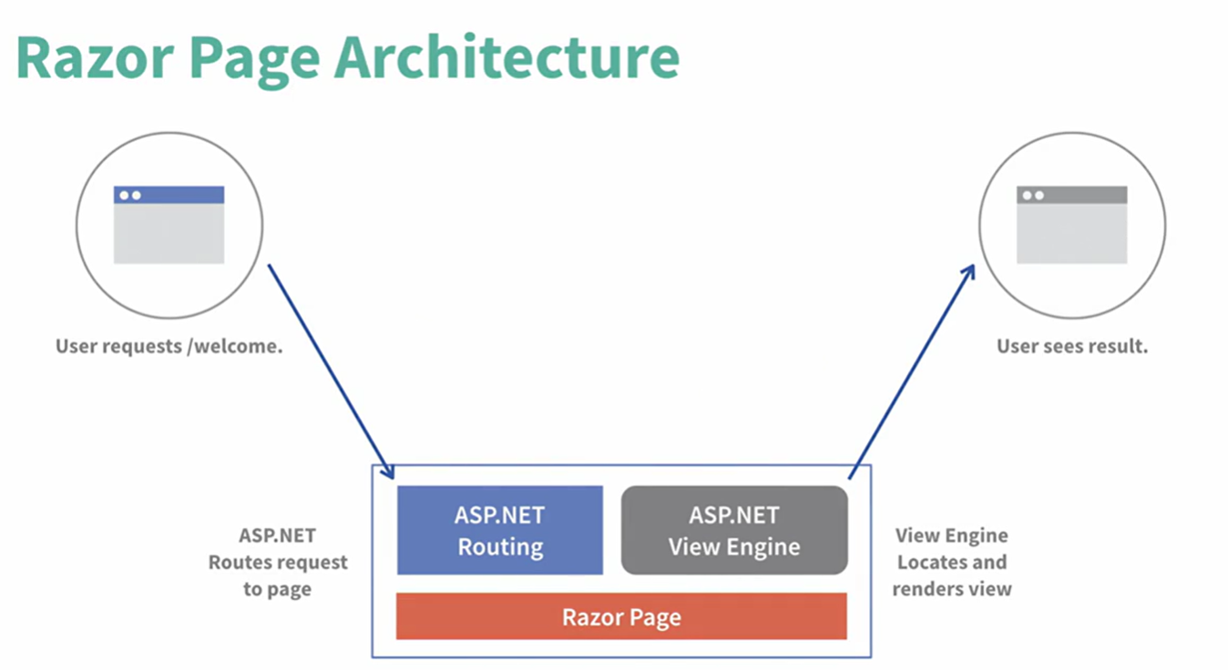

Slide 9
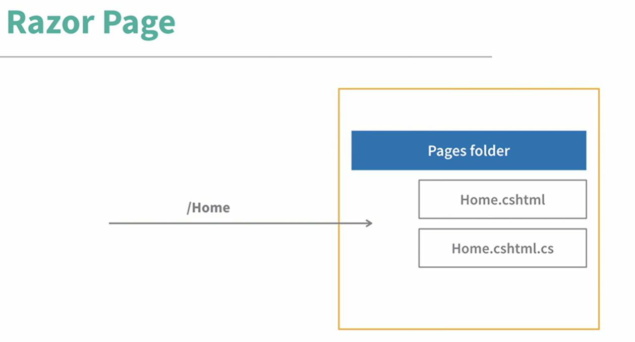

Slide 10
Razor Page Code
public class HomeModel : PageModel
{
public void OnGet()
{
}
}

Slide 11
Razor Pages vs. MVC - comparison
Razor Page | MVC
Everything under Pages folder | Spread over multiple folders
Designed for page-focused scenarios | Controller heavy
Anti-forgery token validation enabled automatically | Anti-forgery token validation enabled manually
Hard to create complex routes | Easy to create complex routes

Slide 12
Razor Pages Concepts
Razor files (or content pages) – intended to be browsable and contain a mixture of client-side & server-side code
@page – directive specifying a razor page
@model – directive specifying the model
@{ . . . } – Razor code block containing C#
Model binding – used to pass data
Model validation

Slide 13
Data Binding
One-way data binding – one directional
Two-way data binding – two directional
Event binding – binding to user actions

Slide 14
One-way data binding examples
Loading data in a table
Getting a profile picture
Displaying date and time on a page

Slide 15
Two-way data binding examples
Calculator
Form validation

Slide 16
Event data binding examples
Clicks
Keystrokes
Touch
Mouse movement

